Slide 1


SCALABLE SYMBOLIC EXECUTION OF DISTRIBUTED SYSTEMS
Presentation by Visesh Bentula

Slide 2

MOTIVATION FOR SYMBOLIC EXECUTION IN DISTRIBUTED SYSTEMS
High-Coverage Testing: Symbolic execution explores many program paths automatically, yielding high coverage and generating concrete inputs for each path. This helps find corner-case bugs with reproducible test cases.
Distributed Systems Challenges: In a distributed system, failures can involve multiple nodes and nondeterministic events (e.g. message losses, races). Such bugs are hard to reproduce, localize, and debug with traditional testing. Symbolic execution promises a systematic way to explore these behaviors.
Goal: Bring the benefits of symbolic execution to networked software. This requires handling multiple interacting node instances symbolically, despite the explosion of state space and the complex communication between nodes. The paper introduces Symbolic Distributed Execution (SDE) to achieve this.

Slide 3
CHALLENGES OF SCALING SYMBOLIC EXECUTION
State Explosion: Executing a network of k nodes multiplies the state space. Path forking in each node can combine exponentially, making naive approaches intractable. Managing the huge number of global states is a core difficulty. Distributed Systems Challenges
State Dependencies: Unlike isolated single-program paths, distributed nodes exchange messages, so one node’s state may affect others. Execution paths across nodes are not independent handling these intra-state dependencies (caused by network communication) is challenging.
Realistic Timing/Ordering: A distributed symbolic executor must also simulate a network model (topology, scheduling). The order of message deliveries and events adds nondeterminism that must be systematically explored, further compounding complexity.

Slide 4
OVERVIEW OF SYMBOLIC DISTRIBUTED EXECUTION (SDE)
DE Approach: SDE runs all nodes’ code symbolically in one integrated execution, effectively treating the whole distributed system as the program under test. It uses a custom state management algorithm to curtail state explosion by merging and reusing states wherever possible.
Key Idea – Minimal State Set: Only keep the minimal number of states needed to represent all divergent behaviors. SDE’s algorithm detects when different execution paths can share the same state for a node (because their past communications are equivalent). By leveraging local node interactions, redundant global states are eliminated.
Implementation: Realized in the tool KleeNet, an extension of KLEE for distributed systems. KleeNet simulates multiple Contiki OS sensor nodes in one process, symbolicizing inputs and network events. SDE’s techniques are general and can integrate into other symbolic execution frameworks.

Slide 5
PROBLEM STATEMENT – THE STATE MAPPING CHALLENGE
Multiple States per Node: In SDE, each node can fork into different execution states (due to symbolic inputs/branches). A global distributed state (or dscenario) is a set of one state per node. As execution proceeds, we get many dscenarios. The challenge is deciding how messages are delivered across these parallel states.
State Mapping Problem: When a node sends a packet, which of the receiving node’s states should get it? If node A has a state that sends a message to node B, but node B has multiple states, we must map the message to the “right” state(s) on B An incorrect mapping (e.g. delivering to a state that shouldn’t receive it) causes a conflict – inconsistent histories between states.
Conflicts: Two states are in conflict if one’s history shows a message sent/received that the other’s does not. For example, if state s of node1 sends a packet that state t of node2 never receives, s and t cannot coexist in the same scenario.
Goal: Develop an online algorithm to decide message deliveries on the fly, detecting and resolving state conflicts as they occur. This algorithm should ensure globally consistent communication histories while minimizing unnecessary state duplication.

Slide 6
BRUTE-FORCE COPY ON BRANCH (COB) ALGORITHM
Idea: COB takes a simple but heavy-handed approach: whenever any node’s execution forks at a branch, duplicate the entire distributed state. Essentially, every branch in one node creates a new dscenario that copies all other nodes’ statesfile. This guarantees each dscenario remains conflict-free (one state per node), but at a tremendous cost in state count.
How it Works: In each step, if node i forks into states s and s’, COB forks every other node’s state as well, producing two dscenarios. Both global scenarios proceed in parallel. All communication is handled within each scenario (no cross-scenario messages), so consistency is trivial – but the number of scenarios explodes.
Correctness vs. Cost: COB never misses any behavior (it’s equivalent to exploring all interleavings), but it produces a huge number of duplicate states. Many states differ only in unrelated branch conditions and do not lead to new code coveragefile. These duplicates waste memory and CPU, greatly slowing exploration.

Slide 7
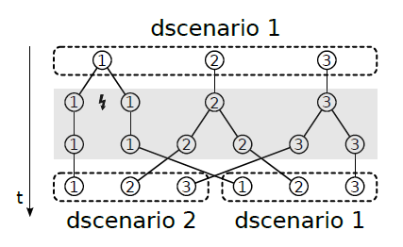
EXAMPLE
Example: A network with k nodes and u branch points can lead to up to 2^(k·u) global states with COB. Even moderate scenarios run out of memory. Clearly, more efficient state mapping is needed despite COB’s conceptual simplicity.
Node1 executes a symbolic branch, creating two local states. COB forks Node2 and Node3’s states (gray shaded) to form two separate dscenarios, each with one state per node. No message was sent, yet COB duplicated the entire system state to preempt conflicts. This yields correct but redundant states on Node2,3

Slide 8
LIMITATIONS OF COB
Exponential Blow-up: COB’s branching policy leads to explosive growth. The worst-case complexity is O(2^(k·u)) (exponential in number of nodes and branch depth). Even for modest networks, the state count becomes unmanageable. For instance, in a 100-node test, COB generated over 1 million states in ~9 hours before exhausting 38 GB of memory.
Duplicate States: A vast majority of COB-generated states are identical in terms of program counter and data (they only differ by having originated in different branch interleavings)file. These duplicate states do not uncover new behaviors – they exist only to maintain the “one state per node” rule. This is pure overhead.
Inefficiency in Practice: The explosion forced the authors to abort COB in the largest scenario. Even in smaller scenarios, COB’s runtime was orders of magnitude slower than improved methods. It’s correct (it explores all possible executions), but far from scalable. Any realistic use of symbolic execution on distributed systems requires a smarter approach to cut down on redundant state expansion.

Slide 9
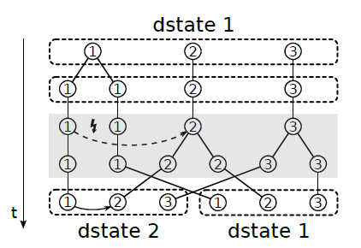
DELAYED COPY-ON-WRITE (COW)
Shared dstate: Several states of the same node stay together if their message histories match, so local branches cause no global forks.
Fork only on message: A new dstate is spawned only when sibling states disagree on sending/receiving a packet; the sender moves, other nodes are copied once, packet delivered there.
Resulting benefit: State growth now follows actual communications, not every branch, slashing duplicates and outperforming COB when traffic is sparse.

Slide 10
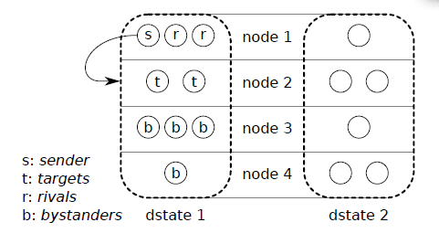
LIMITS OF COPY-ON-WRITE (COW)
Residual duplication: During conflict resolution, COW still clones all bystander nodes—those neither sending nor receiving the packet. These copied states are identical to their originals because they never process the event. The extra clones inflate the overall state count without adding new behavior.
Bystander overhead: In dense or fully-connected topologies, every send spawns many bystander copies. With enough idle neighbors, COW’s state growth can creep back toward COB-level explosion. Broadcast or flooding protocols hit this worst-case scenario.
Memory/runtime impact: While COW beats COB on moderate traffic, its advantage fades in large chatty networks. A 49-node full-mesh test still produced vast duplicates and heavy memory use. This weakness motivated SDS, which removes bystander duplication entirely.

Slide 11
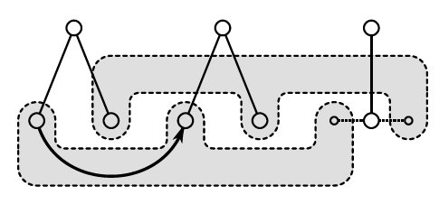
SUPER DSTATES (SDS) ALGORITHM AND VIRTUAL STATES
Virtualize bystanders: When duplication is needed, SDS inserts a virtual state a lightweight reference to the real state instead of copying the node.
One execution, many contexts: Multiple virtual states point to the same actual state, so its code runs once while appearing in several dstates.
Fork only targets: On a packet conflict, SDS forks only the receiving node’s state; the sender and all bystanders remain singletons.
Zero redundant states: Because only diverging targets are copied, SDS never produces two identical configurations, wiping out the duplicate-state blow-up of COB/COW.
Notes:
Instead of copying an entire bystander state, SDS creates virtual states (dashed outlines) as proxies. In this illustration, one actual state (leftmost solid circle) has multiple virtual copies in different dstates (gray region). When a new dstate is needed, SDS “forks” a virtual state (curved arrow) pointing to the same actual state. Thus, the actual state remains unchanged and shared, executing once, while its presence in each dstate is accounted for by virtual states

Slide 12
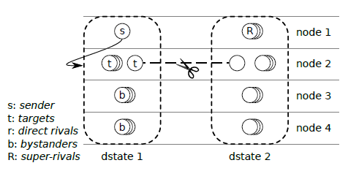
SDS CONFLICT RESOLUTION MECHANISM
Finding Targets: For every virtual instance of the sender, SDS finds the matching virtual targets on the destination node—effectively α parallel “virtual transmissions.”
Rivals and Super-Rivals: Direct rivals share the sender’s dstate; super-rivals share a target’s dstate but not the sender’s, signalling possible cross-scenario clashes.
Forking Rule: A target is forked only when a direct rival could make it both receive and drop the same packet in one dstate—never more than once per target.
Virtual Forking: When a fork is needed, SDS moves conflicting virtual states into a fresh dstate, while bystanders stay singletons via their virtual proxies.
Outcome: Conflicts are resolved with the fewest new states; packets reach only the necessary targets, and bystanders are never duplicated.

Slide 13
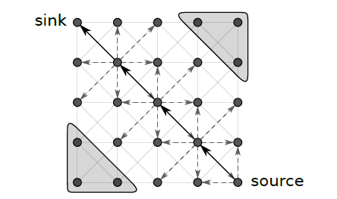
EVALUATION METHODOLOGY (KLEENET)
Testbed: KleeNet (built on KLEE) runs a full Contiki + Rime stack in one process, simulating multiple radio-linked nodes with symbolic choices on every send/receive.
Scenarios: 5×5, 7×7, 10×10 grids (25 / 49 / 100 nodes); bottom-right node sends once-per-second to the top-left sink over a fixed diagonal route during a 10 s run.
Symbolic events: Each node (and its neighbors) can symbolically drop its first heard packet, forking receive vs. loss and creating many path combinations.
Measurement: Collected runtime, total states, and peak RAM per algorithm on a 3.33 GHz Xeon with 64 GB RAM to assess scalability.
Notes:
Test scenario topology (Fig.9
): 25 nodes in a 5×5 grid. Solid black arrows show the fixed data path from the source (bottom-right) to the sink (top-left). Dashed gray arrows indicate broadcast radio range (each node hears its neighbors). Gray triangles mark the source and sink areas. Nodes outside the data path still receive broadcasts (as bystanders). Larger grids (7×7, 10×10) are analogous.

Slide 14
PERFORMANCE RESULTS – RUNTIME, MEMORY, STATES
COB vs COW vs SDS (100 nodes): COB aborted after 9 h 39 m / 1 026 k states / 38 GB RAM; COW finished in 1 h 38 m / 30 k states / 3.4 GB; SDS finished in 19 min / 4.2 k states / 1.6 GB—duplicate-free SDS is fastest and lightest.
State-explosion curves: In 25-, 49-, 100-node runs, COB’s state count rose exponentially, COW rose moderately, SDS barely climbed; the gap widens as node count grows.
Memory usage: COB’s redundant states hit tens of GB; COW cuts memory but still copies bystanders; SDS stays near the number of real events, not path combinations, so RAM remains low.
Scalability: SDS needs < 5 % of COB’s states/RAM and ~10 × less time than COW at 100 nodes; worst-case is still exponential if every node talks every step, but typical protocols are far sparser, giving SDS big wins.
Notes:
Test scenario topology (Fig.9
): 25 nodes in a 5×5 grid. Solid black arrows show the fixed data path from the source (bottom-right) to the sink (top-left). Dashed gray arrows indicate broadcast radio range (each node hears its neighbors). Gray triangles mark the source and sink areas. Nodes outside the data path still receive broadcasts (as bystanders). Larger grids (7×7, 10×10) are analogous.

Slide 15
COMPARISON AND DISCUSSION OF LIMITATIONS
All algorithms are sound: COB, COW, and SDS reach the same global states; SDS just prunes duplicates. Bug-finding power is identical—the gains are purely speed and memory.
When COW/SDS resemble COB: In worst-case traffic (fully-meshed chatter or flooding), even SDS must fork many states and can approach COB-level blow-up. Such cases are rare; typical workloads see huge savings.
Test-case trade-off: SDS stores a compressed execution tree; producing concrete inputs later requires “exploding” dstates. Doing this incrementally still beats COB, but adds post-run cost.
Generality: The SDE algorithms are simulator-agnostic; though implemented in KleeNet/Contiki, they can slot into other symbolic engines or network models, benefiting broader distributed-system testing.
Notes:
Test scenario topology (Fig.9
): 25 nodes in a 5×5 grid. Solid black arrows show the fixed data path from the source (bottom-right) to the sink (top-left). Dashed gray arrows indicate broadcast radio range (each node hears its neighbors). Gray triangles mark the source and sink areas. Nodes outside the data path still receive broadcasts (as bystanders). Larger grids (7×7, 10×10) are analogous.

Slide 16
CONCLUSION AND FUTURE WORK
Summary: SDE combines three state-mapping algorithms (COB, COW, SDS) to scale symbolic execution to multi-node systems, uncovering bugs that manual testing misses.
Key takeaway: By moving from COB to SDS, duplicate states are eliminated, so exploration stays thorough yet far faster and lighter.
Future work – parallelization: Partition independent dstates across CPU cores or machines to accelerate search while preserving mapping consistency.
Future work – incremental tests: Emit concrete test cases on-the-fly as new behaviors appear, avoiding a huge post-run “explosion” step.
Closing: SDE’s duplicate-free approach can slot into other symbolic engines, making exhaustive distributed-system testing practical and dependable.
Notes:
Test scenario topology (Fig.9
): 25 nodes in a 5×5 grid. Solid black arrows show the fixed data path from the source (bottom-right) to the sink (top-left). Dashed gray arrows indicate broadcast radio range (each node hears its neighbors). Gray triangles mark the source and sink areas. Nodes outside the data path still receive broadcasts (as bystanders). Larger grids (7×7, 10×10) are analogous.

Slide 17

THANK YOU

